Slide 1
NP Internship
Final Project

Slide 2
Description
In this project we supposed to control the speed of a DC motor by using PWM module and Timer, we send the speed by UART from another ECU that take the speed by External interrupts and on the receiver ECU we Display the speed.

Slide 3
Functional Requirements
Use 2 Push Buttons to Control Speed using External Interrupts.
Use Uart Communication to send speed from one Ecu to another.
Display the Received speed on LCD .
Control the Motor Using SW PWM Module Based on Timer Interrupt.

Slide 4
NonFunctional Requirements
The system must be responsive
The system must be small in size
The Code must be readable
The modules must be portable
The code must be reusable
The code must be Extendable
The Code must be testable

Slide 5
Static Design

Slide 6
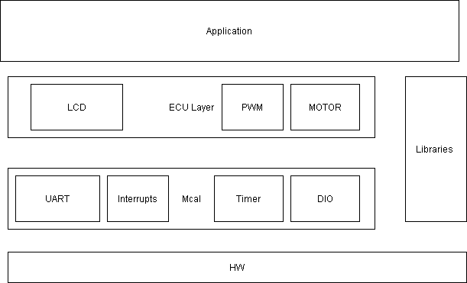
1.Layered Architecture

Slide 7
BSW Components
ECUAL:
Motor
PWM
LCD
MCAL
DIO
Timer
UART
Interrupts

Slide 8
Folder Structure
📦Project ┣ 📂application ┃ ┗📜main ┣ 📂EAL ┃ ┣📜LCD
┃ ┣📜Motor
┃ ┗📜PWM
┣ 📂MCAL ┃ ┣ 📜UART
┃ ┣ 📜Timer
┃ ┣ 📜Interrupts
┃ ┗ 📜DIO ┃ ┗ 📂Infrastructure

Slide 9
Dynamic Design

Slide 10
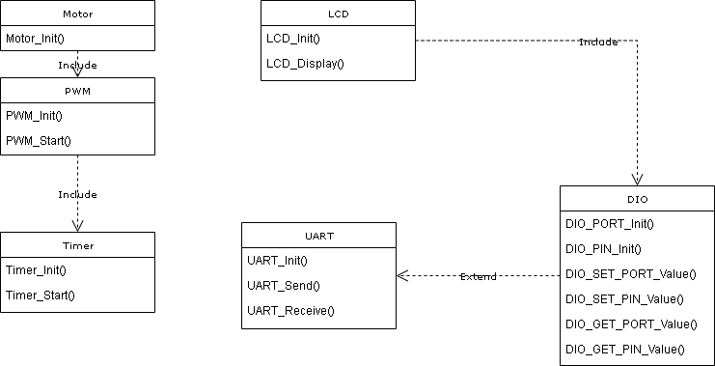
Class Diagram

Slide 11
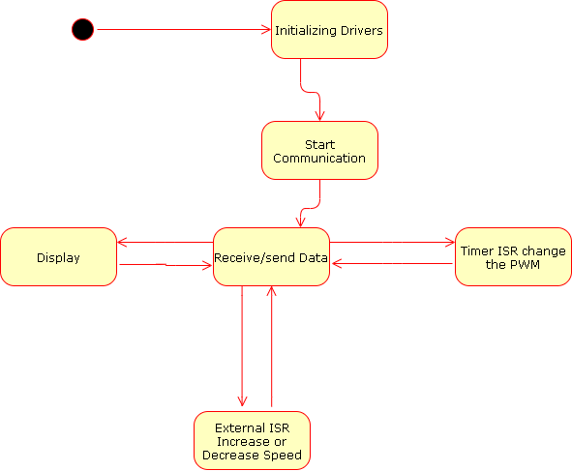
State Machine

Slide 12
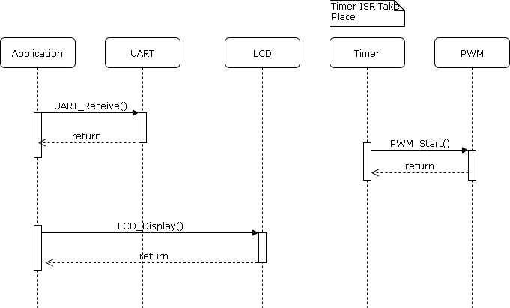
Sequence Diagram :

Slide 13
Corner Cases :
Case 1 :The user press the increase button after reaching 100% speed, the systems will not response in this case.
Case 2 :The user press the decrease button after reaching 0% speed, the systems will not response in this case.

Slide 14
Testing :
The system is full tested 100% as showen in the videos attached with the submissions.

Slide 15
Roles :
Mahmoud Osama(Team Leader) : participated in all modules
Jehad said: participated in all modules .
Nourhan Ramadan : participated in all modules .
Doaa Mohmed : participated in all modules.
Marty Fadi : participated in all modules .

